Slide 1


Teasing out the multi-scale representational space of cross-modal speech perception: mechanisms
Arpan Banerjee
Cognitive Brain Dynamics Lab

Slide 2
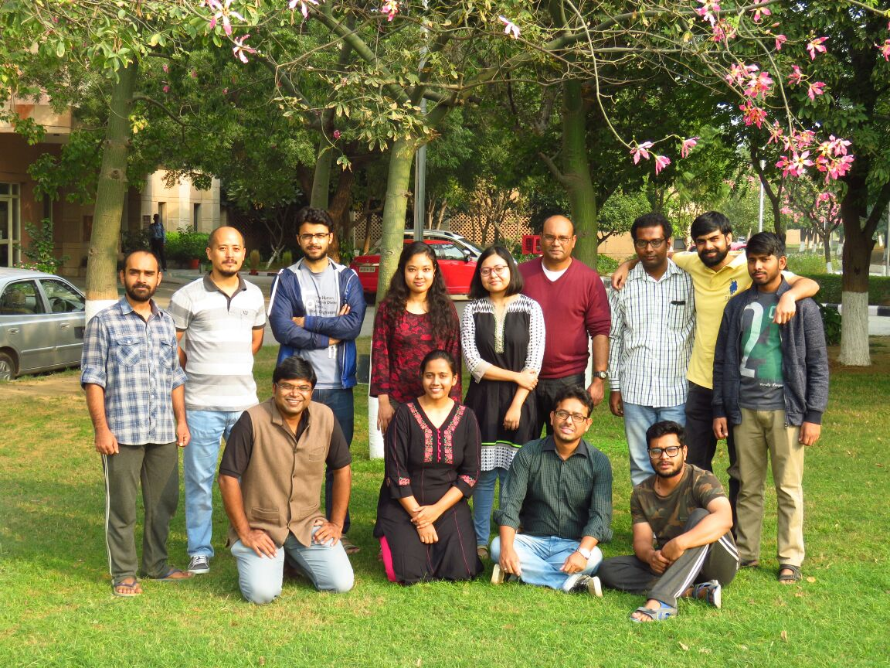
Cognitive Brain Dynamics Lab

Slide 3
Overview
Cross-modal perception in speech
Spatio-temporal localization of cross-modal perception
Computational model of underlying network dynamics

Slide 4
I. Speech perception
Most fundamental mode of human communication (before Facebook!) which is affected in brain injuries (stroke), spectrum disorders
Animal models are hard to construct
Key question: What is the representational space that processes the acts of listening and speaking?

Slide 5
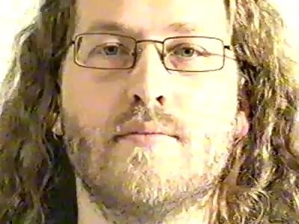
Cross-modal perception in speech
McGurk and McDonald, 1976

Slide 6
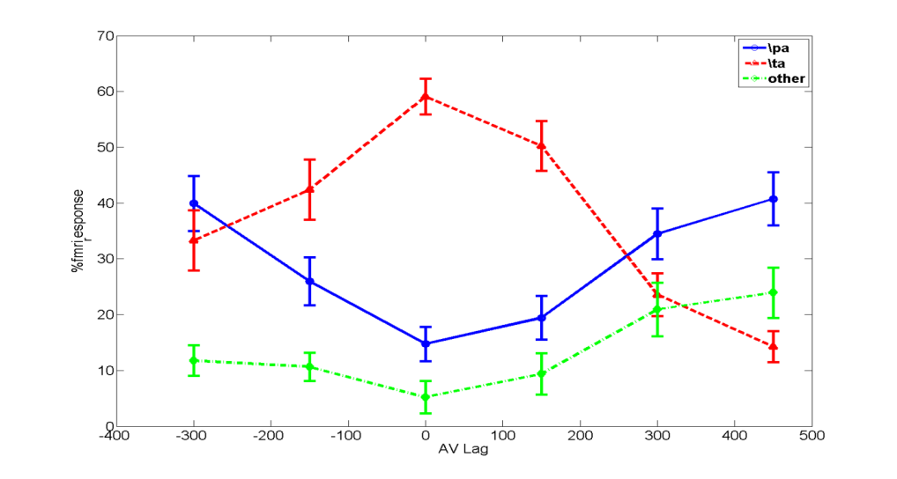
Behavior as a function of time lags
Illusory perception is
mostly reported 0 &
150ms lagged videos
Munhall, 1996
Thakur et al (2016)
Mukherjee et al (in prep)

Slide 7
Points to conceptualize
Multiple senses interact to give rise to perception, sometimes illusory.
Ecological (environmental) contexts give rise to stability and instability of perception, e.g. variation with AV lags
What are the minimum requirements of a multisensory experience

Slide 8

II. Spatiotemporal localization of speech perception
Abhishek Mukherjee
G. Vinodh Kumar

Slide 9
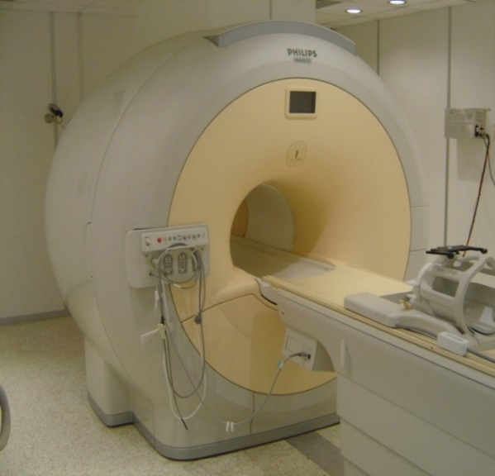
Spatial boundaries of perceptual networks
fMRI of 55 human subjects
3T scanner at NBRC, Manesar
Right handed healthy normals, bilingual population
Abhishek Mukherjee

Slide 10
Representation of cross-modal perception
Behavior
Illusory perception is
mostly reported 0 &
150ms lagged videos
Brain Activation > Rest (p<0.01) FDR corrected (fMRI data, 34 human volunteers)
IFG
pSTS
Lag(-300)
Lag(-150)
Lag(0)
Lag(150)
Lag(300)
Lag(450)
Result: More activity in pSTS only when lags are 0 to 150ms, along with increase in connectivity between IPL, pSTS and IFG
Mukherjee, Raghunathan & Banerjee (in prep)

Slide 11
Representation of cross-modal perception

Slide 12
Key observations
Activation in posterior superior temporal sulcus (pSTS), inferior frontal gyrus (IFG), auditory cortex and V5 increases with temporal congruency of audio-visual stimulus.
When blocks were sorted according to perceptual categorization as maximal illusory, minimal illusory, pSTS, SPL activations were observed in Max /ta
We hypothesize cross-modal perception is exclusively facilitated by a network pSTS, SPL and higher order visual and auditory areas that may not be necessarily activated by cross-modal stimuli.

Slide 13
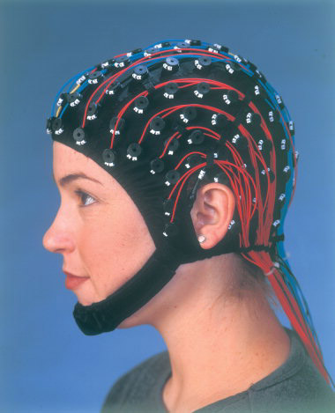
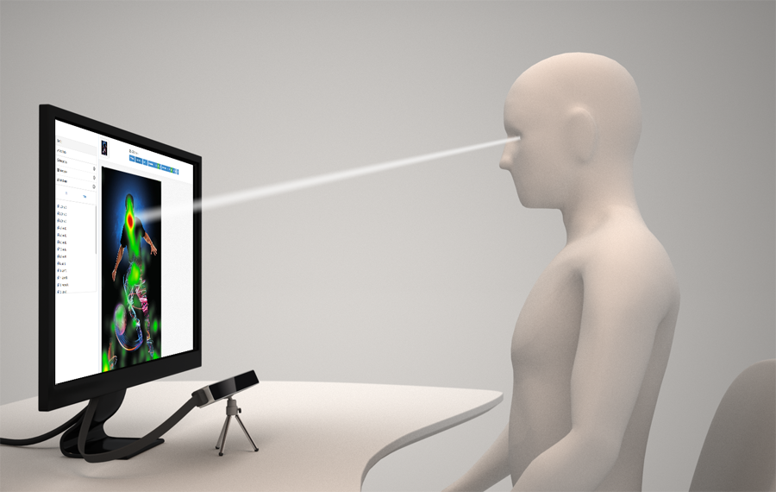
Large scale network dynamics of cross-modal perception: EEG
25 healthy normal humans , right handed and bilingual
No history of imapaired auditory processing/ neurological disorders
Kumar et. al Frontiers in Psychology (2016)
Kumar et. al Multsensory Res (2017)
G. Vinodh Kumar

Slide 14
Results: Behavior , 15 frequent and 10 rare perceivers

Slide 15
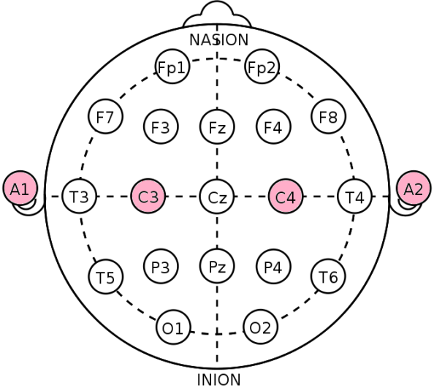
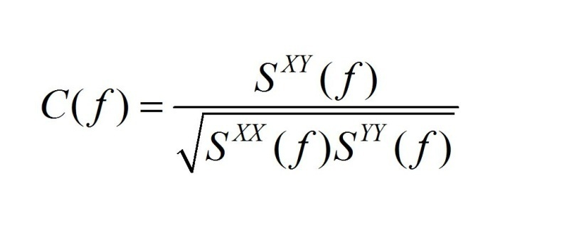
Coherence: Spectral representation of neuronal coordination
Coherence is an estimator of the brain network

Slide 16
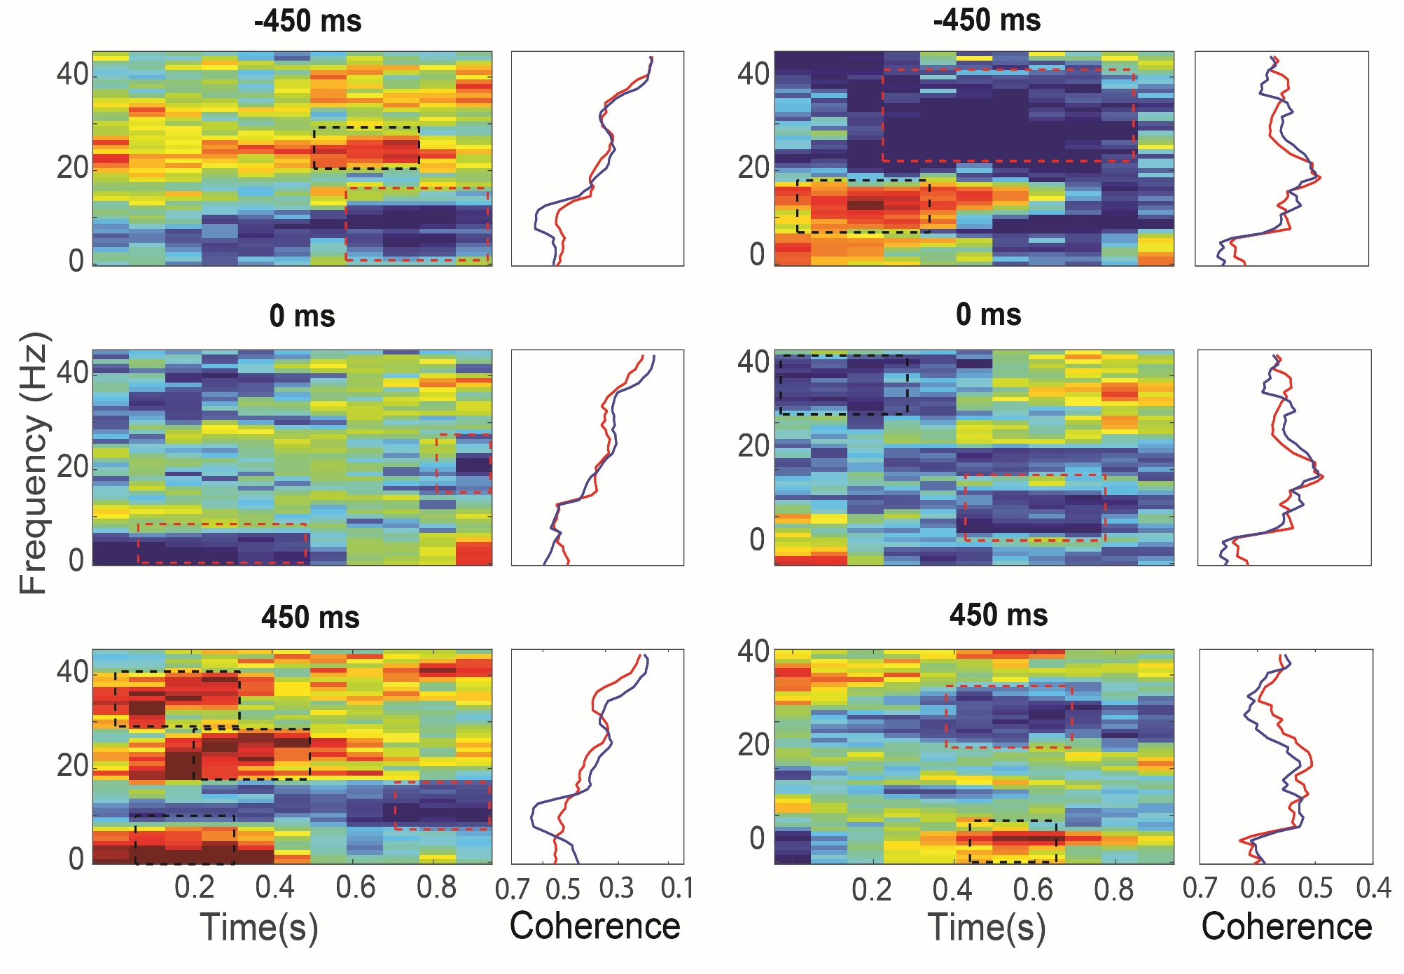
15 frequent perceivers 10 rare perceivers
Alpha coherence peak
absent in rare perceivers

Slide 17
Within frequent perceivers (Inter-trial variability)
0 lag has broadband gamma coherence getting increased along with a decrease in alpha coherence
In 450 and -450 ms lag broadband increase in gamma coherence was absoer

Slide 18
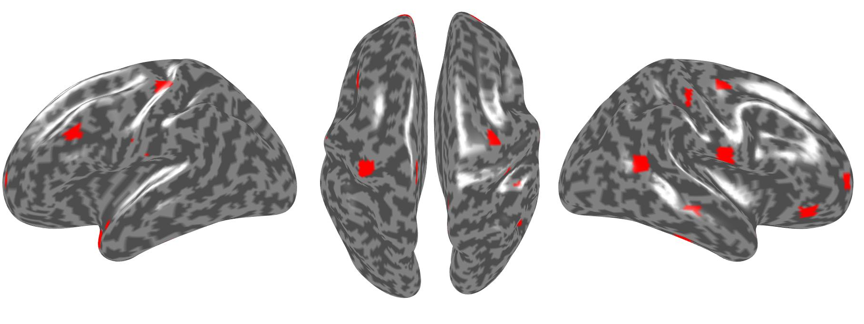
Source localization in frequent and rare perceivers
Cortical locations where source power ta/pa significantly higher. Surprisingly distribution were identical for frequent and rare perceivers

Slide 19
Interim summary
Inter-trial and inter group variability may originate from two different cortical oscillations
Several areas observed in fMRI could also be found out by source localization to create a etwork model.

Slide 20
III. Detailed model of cross-modal perception
Auditory cortex
pSTS
Shrey Dutta

Slide 21
Large-scale model of multisensory of perception
Kumar, Dutta et al (in
progress)

Slide 22
Predicting the neural dynamics of rare perceivers

Slide 23
Summary
Dynamic framework of multisensory experience that captures biophysically realistic functional connectivity and environmental constraints as key mediators of perceptual experience
Multimodal (EEG/MRI) and multi-level representation (segregation/ integration/ coherence of EEG signals) of perceptual experience in the brain
Whole-brain analysis techniques give insights to the representational space of multisensory perception
Interactions between fast and slow time-scale systems are crucial in multisensory integration

Slide 24
Summary
Cross-modal perception in speech
Spatio-temporal localization of cross-modal perception
Computational model of underlying network dynamics

Slide 25
Funding
Department of Biotechnology (Ramalingaswami & IYBA)
Department of Science and Technology (CSRI)
Science Education and Research Board (SERB)
NBRC Core

Slide 26
THANK YOU

